Slide 1

Network :structural chracteristics
Clustering Coefficients
Closeness Centrality
Betweenness Centrality
Eigenvector Centrality
Gephi
Notes:
The Human Disease Network, whose nodes are diseases connected if they have common genetic origin.
K.-I. Goh, M. E. Cusick, D. Valle, B. Childs, M. Vidal, and A.-L. Barabasi.
The human disease network. PNAS, 104:8685–8690, 2007.

Slide 2

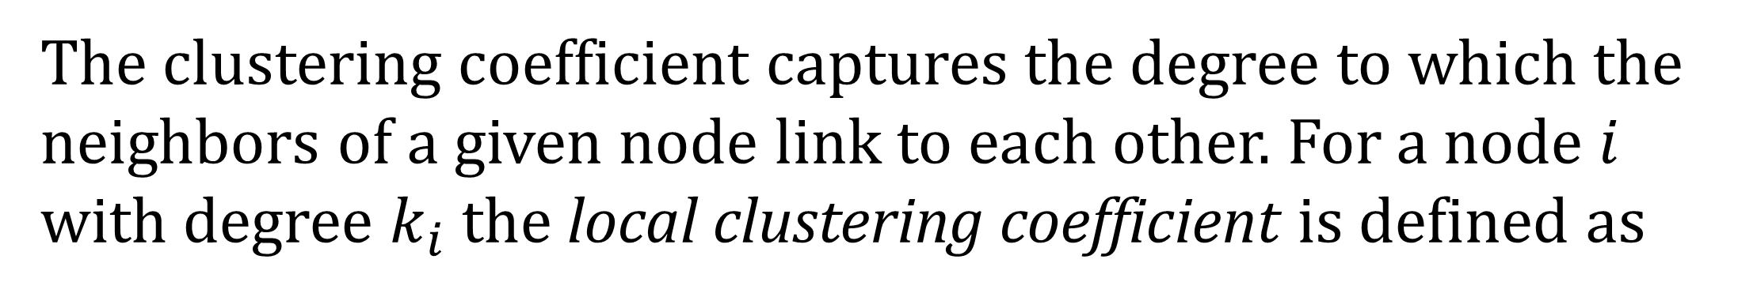
Clustering Coefficients
The clustering coefficient captures the degree to which the neighbors of a given node link to each other. For a node $i$ with degree $k_{i}$ the local clustering coefficient is defined as
Notes:
The Human Disease Network, whose nodes are diseases connected if they have common genetic origin.
K.-I. Goh, M. E. Cusick, D. Valle, B. Childs, M. Vidal, and A.-L. Barabasi.
The human disease network. PNAS, 104:8685–8690, 2007.

Slide 3
Clustering Coefficients
The clustering coefficient captures the degree to which the neighbors of a given node link to each other. For a node $i$ with degree $k_{i}$ the local clustering coefficient is defined as
CC of the center node (purple)
Notes:
The Human Disease Network, whose nodes are diseases connected if they have common genetic origin.
K.-I. Goh, M. E. Cusick, D. Valle, B. Childs, M. Vidal, and A.-L. Barabasi.
The human disease network. PNAS, 104:8685–8690, 2007.

Slide 4
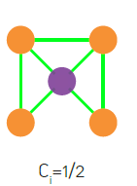
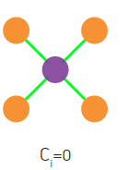
Clustering Coefficients
The clustering coefficient captures the degree to which the neighbors of a given node link to each other. For a node $i$ with degree $k_{i}$ the local clustering coefficient is defined as
CC of the center node (purple)
Notes:
The Human Disease Network, whose nodes are diseases connected if they have common genetic origin.
K.-I. Goh, M. E. Cusick, D. Valle, B. Childs, M. Vidal, and A.-L. Barabasi.
The human disease network. PNAS, 104:8685–8690, 2007.

Slide 5
Clustering Coefficients
Notes:
The Human Disease Network, whose nodes are diseases connected if they have common genetic origin.
K.-I. Goh, M. E. Cusick, D. Valle, B. Childs, M. Vidal, and A.-L. Barabasi.
The human disease network. PNAS, 104:8685–8690, 2007.

Slide 6
Clustering Coefficients
n=length(G);
C=zeros(n,1);
for u=1:n
V=find(G(u,:));
k=length(V);
if k>=2 %degree must be at least 2
S=G(V,V);
C(u)=sum(S(:))/(k^2-k);
end
end
https://github.com/mdhumphries/SmallWorldNess
Notes:
The Human Disease Network, whose nodes are diseases connected if they have common genetic origin.
K.-I. Goh, M. E. Cusick, D. Valle, B. Childs, M. Vidal, and A.-L. Barabasi.
The human disease network. PNAS, 104:8685–8690, 2007.

Slide 7
Clustering Coefficients
Notes:
The Human Disease Network, whose nodes are diseases connected if they have common genetic origin.
K.-I. Goh, M. E. Cusick, D. Valle, B. Childs, M. Vidal, and A.-L. Barabasi.
The human disease network. PNAS, 104:8685–8690, 2007.

Slide 8
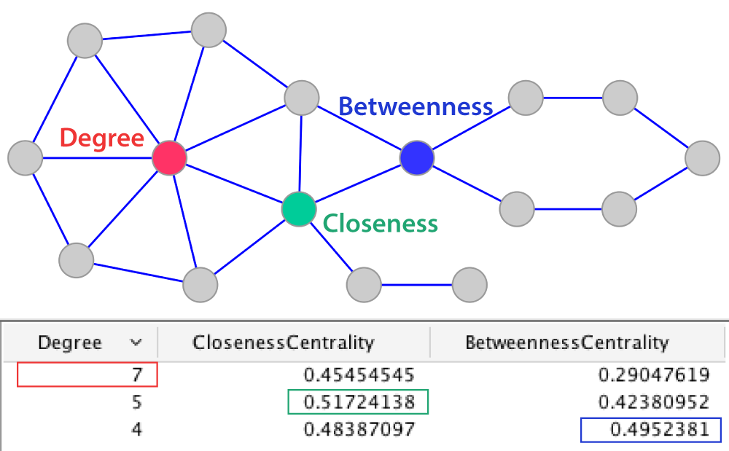

Centralities
$$C_{i}=1/{\sum_{j=1}^{n}{d(i,j)}}$$
Ralucca Gera, NPS

Slide 9
Centralities
$$C_{i}=1/{\sum_{j=1}^{n}{d(i,j)}}$$
Ralucca Gera, NPS

Slide 10
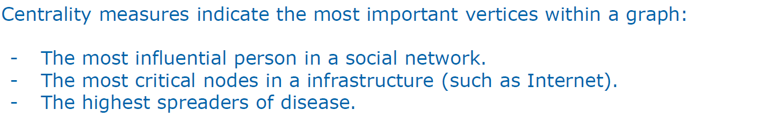
Network Analysis: Centrality measures

Slide 11
Network Analysis: Centrality measures

Slide 12
Different types of centralities
What makes a vertex central in a network? (one or more ideas) | How do you describe it mathematically? | When is it appropriate to use it? | How can we capture it?

Slide 13
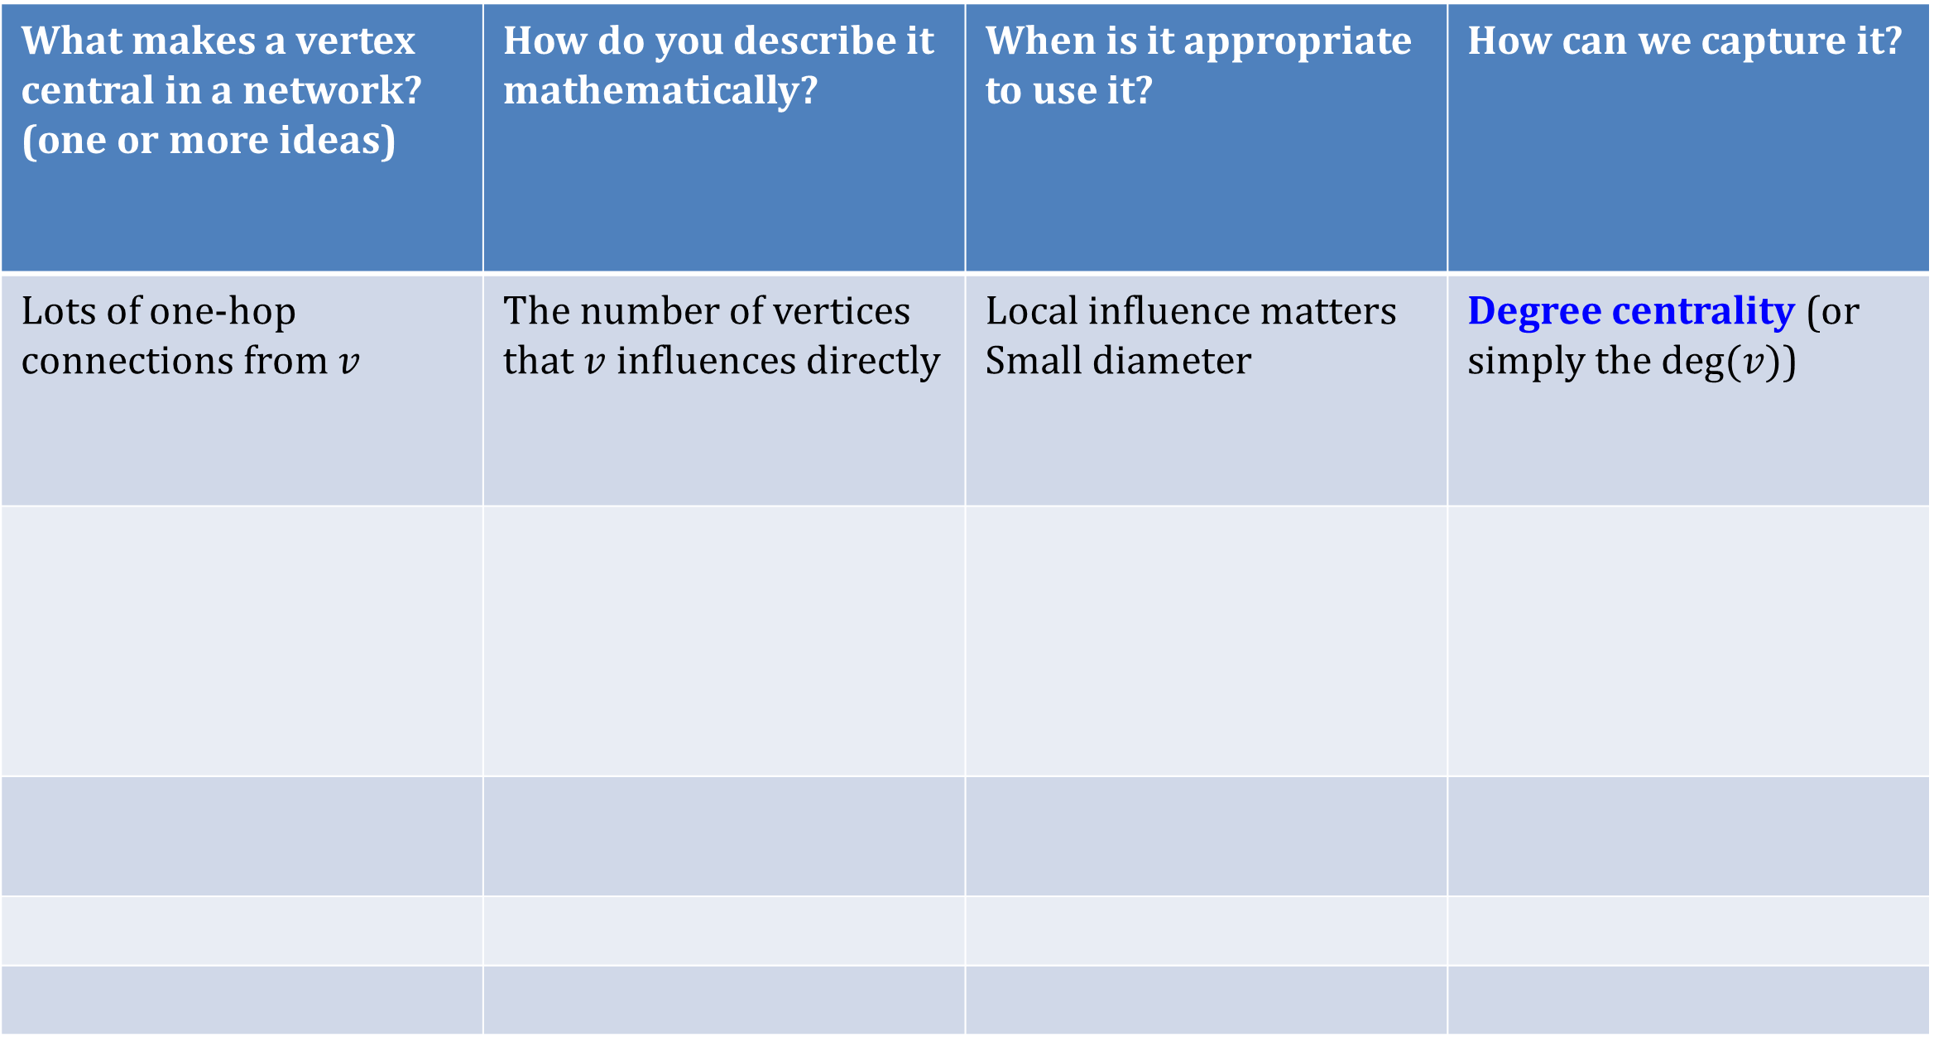
Different types of centralities
What makes a vertex central in a network? (one or more ideas) | How do you describe it mathematically? | When is it appropriate to use it? | How can we capture it?
Lots of one-hop connections from $v$ | The number of vertices that $v$ influences directly | Local influence matters Small diameter | Degree centrality (or simply the $deg⁡(v)$)

Slide 14
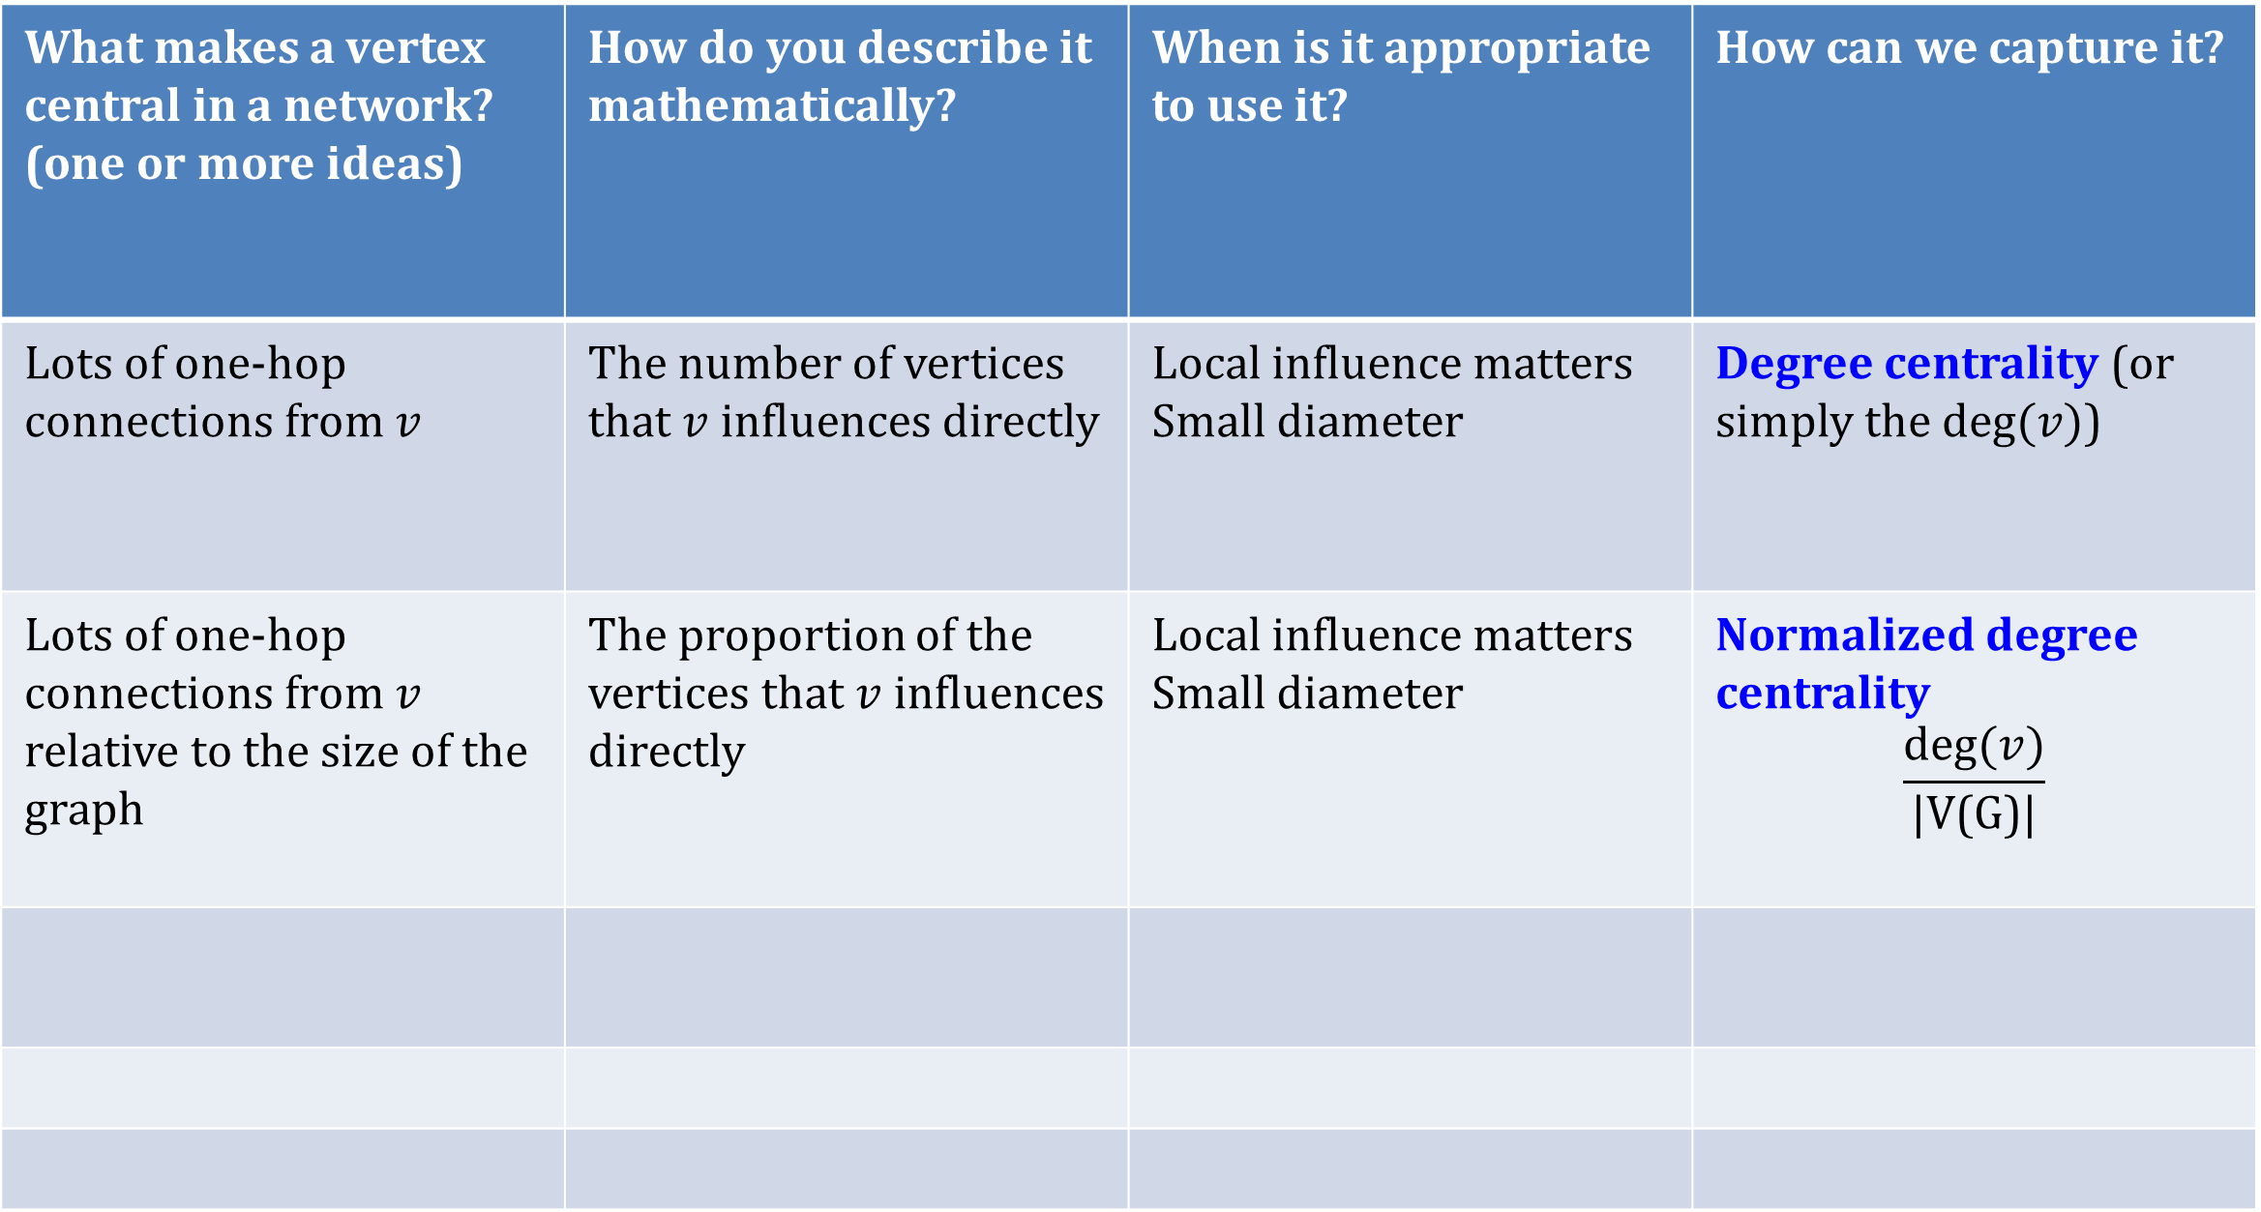
Different types of centralities
What makes a vertex central in a network? (one or more ideas) | How do you describe it mathematically? | When is it appropriate to use it? | How can we capture it?
Lots of one-hop connections from $v$ | The number of vertices that $v$ influences directly | Local influence matters Small diameter | Degree centrality (or simply the $deg⁡(v)$)
Lots of one-hop connections from $v$ relative to the size of the graph | The proportion of the vertices that $v$ influences directly | Local influence matters Small diameter | Normalized degree centrality $$\frac{deg⁡(v)}{\text{|V(}\text{G}\text{)|}}$$

Slide 15
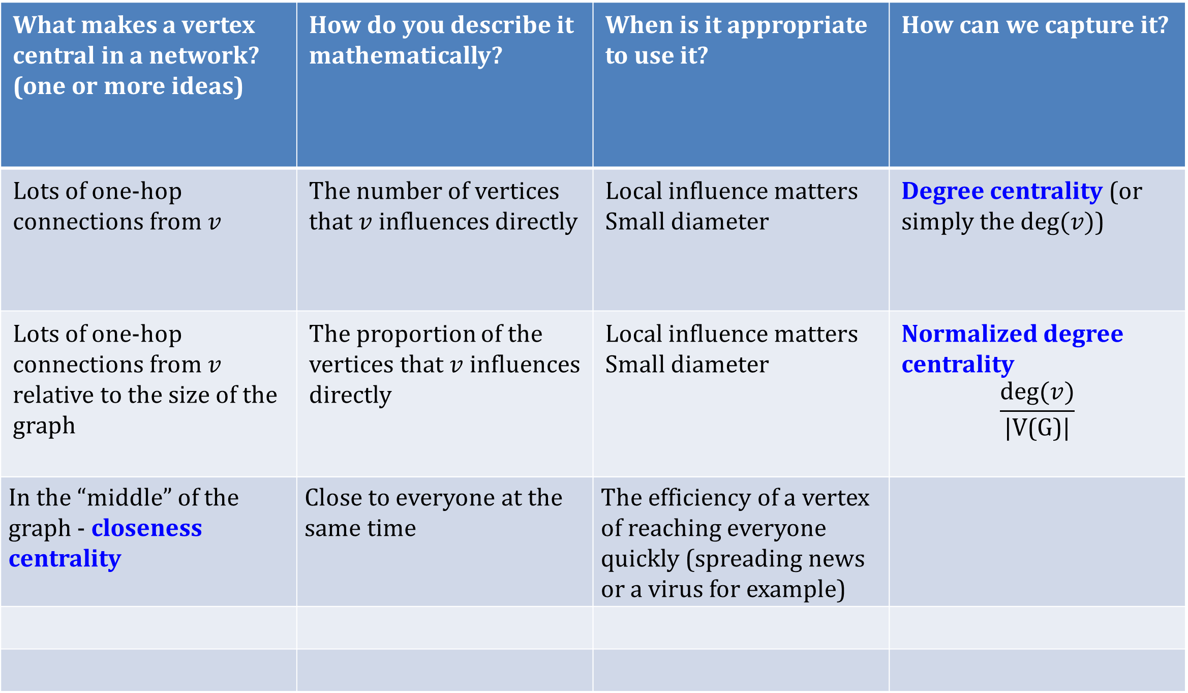
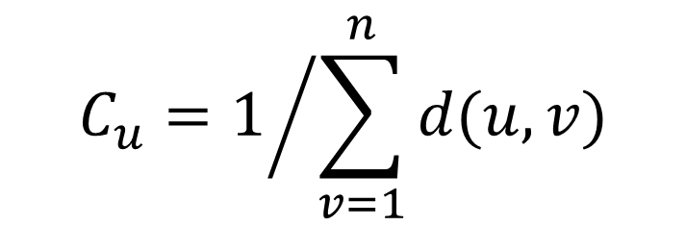
Different types of centralities
What makes a vertex central in a network? (one or more ideas) | How do you describe it mathematically? | When is it appropriate to use it? | How can we capture it?
Lots of one-hop connections from $v$ | The number of vertices that $v$ influences directly | Local influence matters Small diameter | Degree centrality (or simply the $deg⁡(v)$)
Lots of one-hop connections from $v$ relative to the size of the graph | The proportion of the vertices that $v$ influences directly | Local influence matters Small diameter | Normalized degree centrality $$\frac{deg⁡(v)}{\text{|V(}\text{G}\text{)|}}$$
In the “middle” of the graph - closeness centrality | Close to everyone at the same time | The efficiency of a vertex of reaching everyone quickly (spreading news or a virus for example)
$$C_{u}=1/{\sum_{v=1}^{n}{d(u,v)}}$$

Slide 17
Event synchronization
#pk, Saral APP

Slide 21
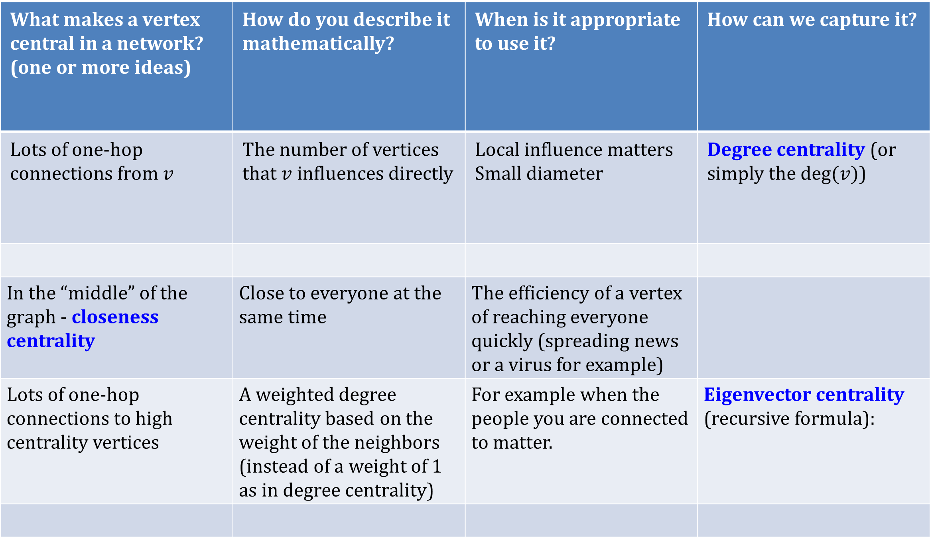
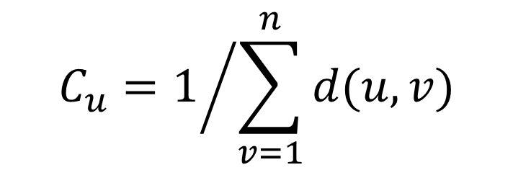
Different types of centralities
What makes a vertex central in a network? (one or more ideas) | How do you describe it mathematically? | When is it appropriate to use it? | How can we capture it?
Lots of one-hop connections from $v$ | The number of vertices that $v$ influences directly | Local influence matters Small diameter | Degree centrality (or simply the $deg⁡(v)$)
In the “middle” of the graph - closeness centrality | Close to everyone at the same time | The efficiency of a vertex of reaching everyone quickly (spreading news or a virus for example)
Lots of one-hop connections to high centrality vertices | A weighted degree centrality based on the weight of the neighbors (instead of a weight of 1 as in degree centrality) | For example when the people you are connected to matter. | Eigenvector centrality (recursive formula):
$$C_{u}=1/{\sum_{v=1}^{n}{d(u,v)}}$$
Ralucca Gera, NPS

Slide 22
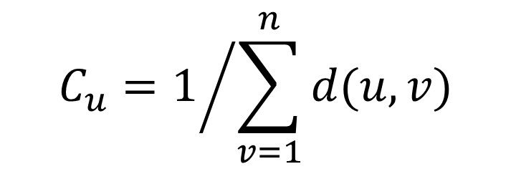
Closeness Centrality
Reciprocal of the total distance from a node u to all the other nodes in a network
d(u,v) is the distance between node u and v.
$$C_{u}=1/{\sum_{v=1}^{n}{d(u,v)}}$$
$$C_{i}=1/{\sum_{j=1}^{n}{d(i,j)}}$$
Closeness centrality can be viewed as the efficiency of a vertex in spreading information to all other vertices.
Ralucca Gera, NPS

Slide 23
Eigenvector Centrality
A natural extension of degree centrality is eigenvector centrality.
$$C_{i}=1/{\sum_{j=1}^{n}{d(i,j)}}$$
Ralucca Gera, NPS

Slide 24
Eigenvector Centrality
A natural extension of degree centrality is eigenvector centrality.
In-degree centrality awards one centrality point for every link a node receives. But not all vertices are equivalent: some are more relevant than others, and, reasonably, endorsements from important nodes count more.
$$C_{i}=1/{\sum_{j=1}^{n}{d(i,j)}}$$
Ralucca Gera, NPS

Slide 25
Eigenvector Centrality
A natural extension of degree centrality is eigenvector centrality.
In-degree centrality awards one centrality point for every link a node receives. But not all vertices are equivalent: some are more relevant than others, and, reasonably, endorsements from important nodes count more.
EVC : A node is important if it is linked to by other important nodes.
$$C_{i}=1/{\sum_{j=1}^{n}{d(i,j)}}$$
Ralucca Gera, NPS

Slide 26
Eigenvector Centrality
$$C_{i}=1/{\sum_{j=1}^{n}{d(i,j)}}$$
Ralucca Gera, NPS

Slide 27
Eigenvector Centrality
$$C_{i}=1/{\sum_{j=1}^{n}{d(i,j)}}$$
Ralucca Gera, NPS

Slide 28
Eigenvector Centrality
$$C_{i}=1/{\sum_{j=1}^{n}{d(i,j)}}$$
Ralucca Gera, NPS

Slide 29
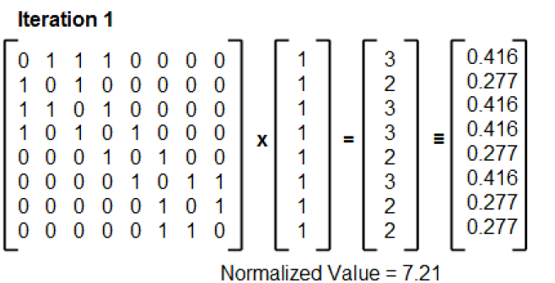
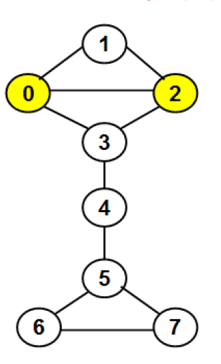
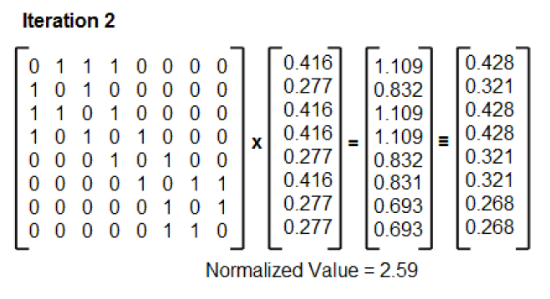
Eigenvector Centrality
$$C_{i}=1/{\sum_{j=1}^{n}{d(i,j)}}$$
Dr. Natarajan Meghanathan
Ralucca Gera, NPS

Slide 30
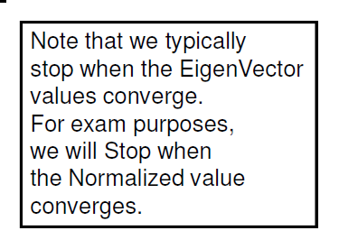
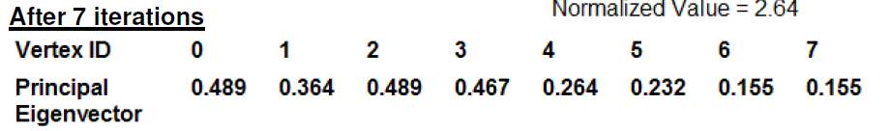
Eigenvector Centrality
$$C_{i}=1/{\sum_{j=1}^{n}{d(i,j)}}$$
Ralucca Gera, NPS

Slide 31
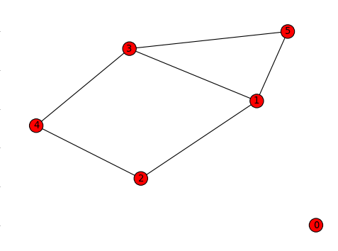
Eigenvector Centrality
clear all
A=zeros(6,6);
A(5,[1 3])=1;
A(2,[1 4])=1;
A([1 4],3)=1;
A=A+A';
[u lam]=eig(A);
evc_large=u(:,6);
$$C_{i}=1/{\sum_{j=1}^{n}{d(i,j)}}$$
Ralucca Gera, NPS

Slide 32

Eigenvector Centrality
Example 1 (Eigenvector centrality)
Node $i$: Eigenvect. centrality $C_{i}$
0: 0,
1: 0.5298987782873977,
2: 0.3577513877490464,
3: 0.5298987782873977,
4: 0.3577513877490464,
5: 0.4271328349194304

Slide 33

Eigenvector Centrality
Example 1 (Eigenvector centrality)
Node $i$: Eigenvect. centrality $C_{i}$
0: 0,
1: 0.5298987782873977,
2: 0.3577513877490464,
3: 0.5298987782873977,
4: 0.3577513877490464,
5: 0.4271328349194304

Slide 34

Eigenvector Centrality
Example 1 (Eigenvector centrality)
Node $i$: Eigenvect. centrality $C_{i}$
0: 0,
1: 0.5298987782873977,
2: 0.3577513877490464,
3: 0.5298987782873977,
4: 0.3577513877490464,
5: 0.4271328349194304
Notice that deg(5) = deg (4). Why $C_{5}>C_{4} ?$

Slide 35
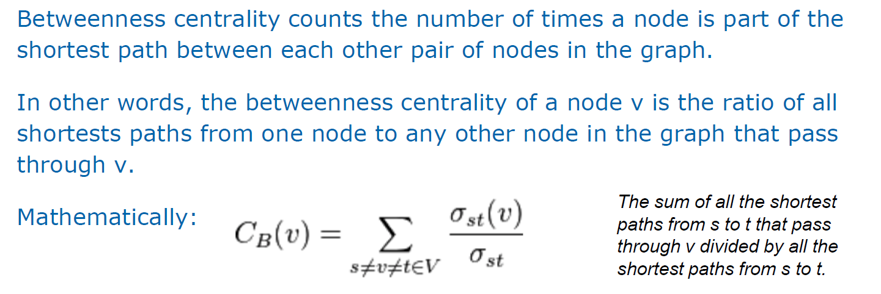
Node Betweenness
$$C_{i}=1/{\sum_{j=1}^{n}{d(i,j)}}$$
Shortest path based betweenness centrality
Ralucca Gera, NPS

Slide 36
Centralities
$$C_{i}=1/{\sum_{j=1}^{n}{d(i,j)}}$$
Ralucca Gera, NPS

Slide 37
Centralities
betweenness closeness
1 7 0.381944444444445 0.454545454545455
2 3 0 0.405405405405405
3 3 0 0.384615384615385
4 3 0 0.333333333333333
5 3 0 0.333333333333333
6 3 0 0.333333333333333
7 4 0.244444444444444 0.483870967741936
8 5 0.475000000000000 0.517241379310345
9 4 0.604166666666667 0.483870967741936
10 2 0.225000000000000 0.365853658536585
11 2 0.0930555555555556 0.294117647058824
12 2 0.0208333333333333 0.245901639344262
13 2 0.0166666666666667 0.294117647058824
14 2 0.148611111111111 0.365853658536585
15 2 0.208333333333333 0.365853658536585
16 1 0 0.272727272727273
$$C_{i}=1/{\sum_{j=1}^{n}{d(i,j)}}$$
Ralucca Gera, NPS

Slide 38
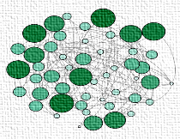
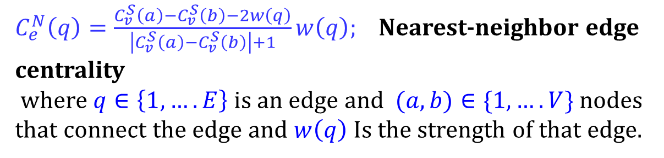
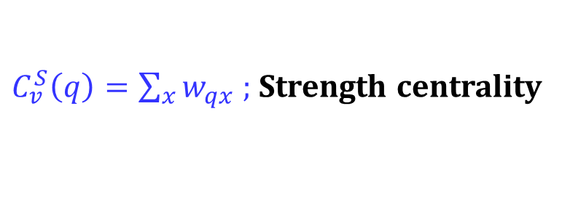

Node-based and edge-based centralites
$C_{v}^{S}\left(q\right)=\sum_{x}{w_{qx} }$; Strength centrality
$C_{e}^{N}\left(q\right)=\frac{C_{v}^{S}\left(a\right)−C_{v}^{S}\left(b\right)−2w\left(q\right)}{\left|C_{v}^{S}\left(a\right)−C_{v}^{S}\left(b\right)\right|+1}w\left(q\right)$; Nearest-neighbor edge centrality
where $q∈\left\{1,….E\right\}$ is an edge and $(a,b)∈\{1, ….V\}$ nodes that connect the edge and $w\left(q\right)$ Is the strength of that edge.
Centrality-based identification of important edges in complex networks T Bröhl, K Lehnertz, Chaos: An Interdisciplinary Journal of Nonlinear Science 29 (3)
A straightforward edge centrality concept derived from generalizing degree and strength, T Bröhl, K Lehnertz, Scientific Reports 12 (1), 4407

Slide 39
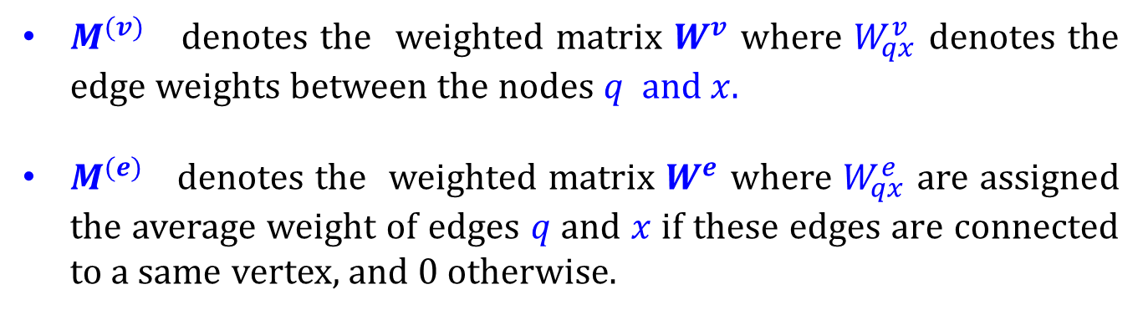
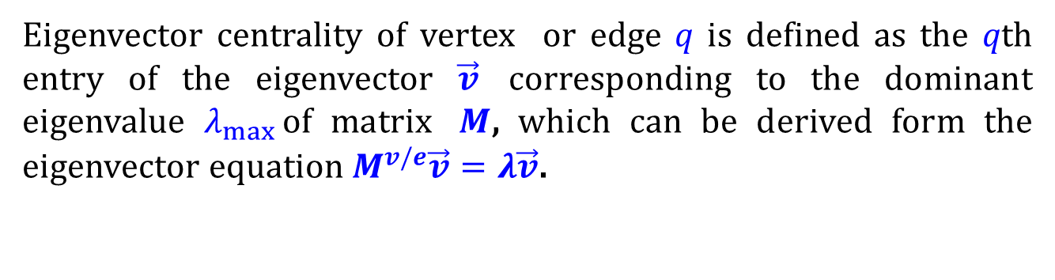
Node-based and edge-based centralites
$C_{v,e}^{E}\left(q\right)=\frac{1}{λ_{max}}\sum_{x}{M_{qx}^{v/e} C_{v,e}^{E}}\left(x\right)$ ; Eigenvector centrality
Eigenvector centrality of vertex or edge 𝑞 is defined as the 𝑞th entry of the eigenvector $\vec{v}$ corresponding to the dominant eigenvalue $λ_{max}⁡$of matrix $M$, which can be derived form the eigenvector equation $M^{v/e}\vec{v}=λ\vec{v}$.
$M^{(v)}$ denotes the weighted matrix $W^{v}$ where $W_{qx}^{v}$ denotes the edge weights between the nodes $q$ and $x.$
$M^{(e)}$ denotes the weighted matrix $W^{e}$ where $W_{qx}^{e}$ are assigned the average weight of edges 𝑞 and 𝑥 if these edges are connected to a same vertex, and 0 otherwise.

Slide 40
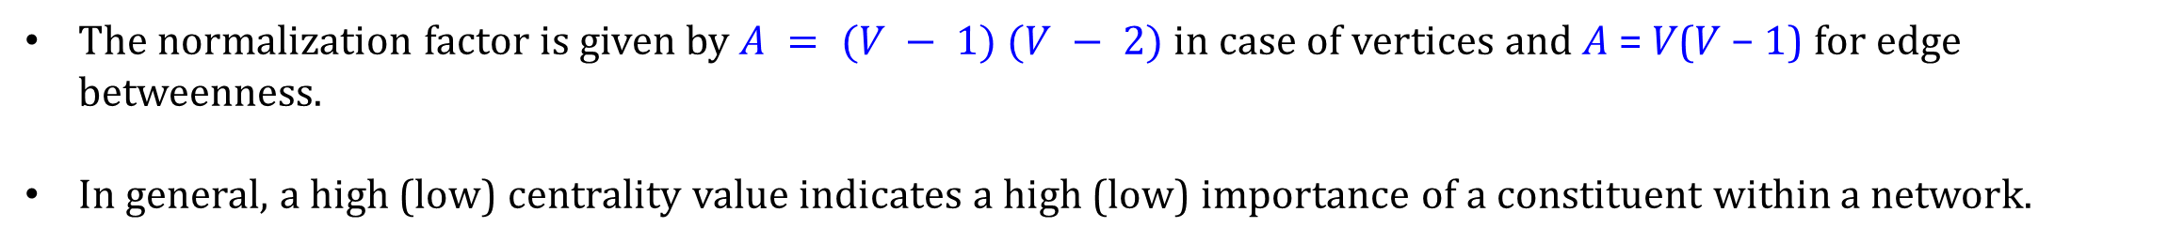
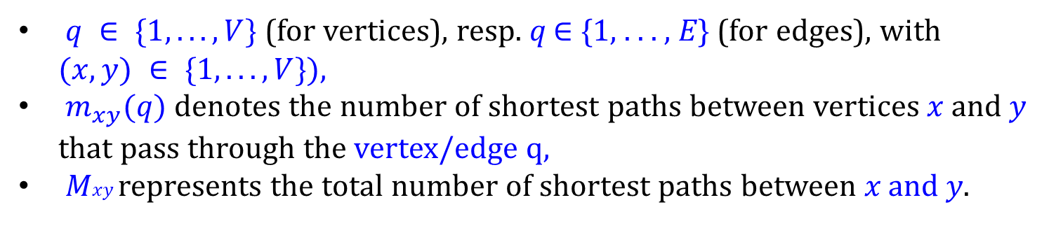
Node-based and edge-based centralites
$C_{v,e}^{B}(q)=\frac{2}{A}\sum_{x≠y}{\frac{m_{xy}(q)}{M_{xy}}\text{ ; }\text{B}\text{etweenness centrality}}$
$q ∈ \{1, . . . ,V\}$(for vertices), resp. 𝑞 ∈ {1, . . . , 𝐸} (for edges), with $(x, y) ∈ \{1, . . . ,V\}),$
$m_{xy}(q)$denotes the number of shortest paths between vertices 𝑥 and 𝑦 that pass through the vertex/edge q,
𝑀𝑥𝑦 represents the total number of shortest paths between 𝑥 and 𝑦.
The normalization factor is given by $A = (V − 1) (V − 2)$in case of vertices and 𝐴 = 𝑉(𝑉 − 1) for edge betweenness.
In general, a high (low) centrality value indicates a high (low) importance of a constituent within a network.

Slide 41
Node-based and edge-based centralites
$C_{v}^{C}(q)=\frac{V−1}{\sum_{x}{m_{qx}}}$; Vertex closeness centrality
$C_{e}^{C}(q)=\frac{E−1}{\sum_{x}{m_{xa}+m_{xb}}}$ ; Edge closeness centrality

Slide 42
Complete and bipartite graph
The complete graph on n vertices is denoted K_{n}, and is the graph on n vertices where every pair of distinct vertices are adjacent.
A bipartite graph is one where the vertices are divided into two classes, R and B say, with the property that every edge has one end in R and the other end in B. Star and lattices.

Slide 43
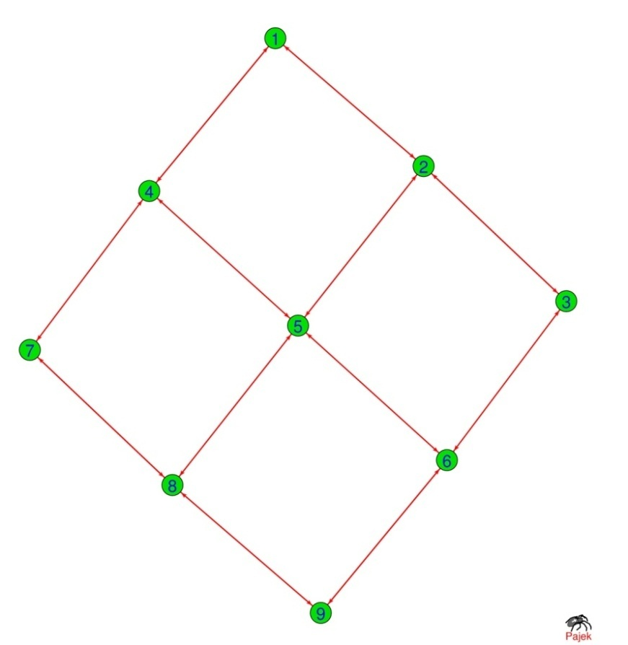
Bipartite graph
1
3
5
7
9
4
2
6
8

Slide 44
Bipartite Graphs: Subprojections
A bipartite graph (or bigraph) is a network whose nodes can be divided into two disjoint sets U and V such that each link connects a U-node to a V-node. In other words, if we color the U-nodes green and the V-nodes purple, then each link must connect nodes of different colors.
Notes:
The Human Disease Network, whose nodes are diseases connected if they have common genetic origin.
K.-I. Goh, M. E. Cusick, D. Valle, B. Childs, M. Vidal, and A.-L. Barabasi.
The human disease network. PNAS, 104:8685–8690, 2007.

Slide 45
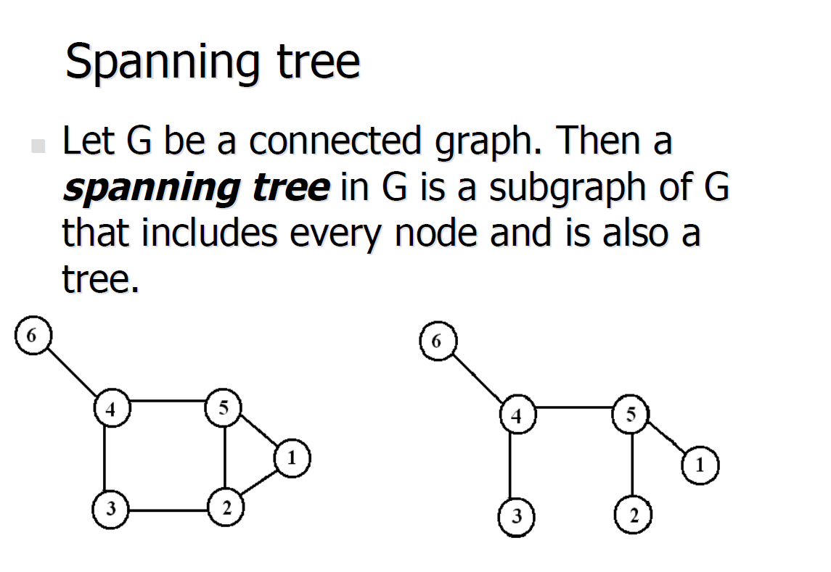
Spanning Tree
Notes:
The Human Disease Network, whose nodes are diseases connected if they have common genetic origin.
K.-I. Goh, M. E. Cusick, D. Valle, B. Childs, M. Vidal, and A.-L. Barabasi.
The human disease network. PNAS, 104:8685–8690, 2007.

